Slide 1


Microsoft® Lync™ 2010
Voice and Video Training

Slide 2
Objectives
This course covers the following voice and video features of the Lync 2010 client.
Make a Call
Answer a Call
Manage a Call
Forward a Call
Follow up on Missed Calls and Voice Mail
Join a Conference Call
Join a Video Call
Accept a Video Call

Slide 3

Video Objectives
Voice
This section covers the following:
Make a Call
Answer a Call
Manage your Conversation and Device Settings
Forward Calls
Follow up on Missed Calls and Voice Mail
Join a Conference Call

Slide 4
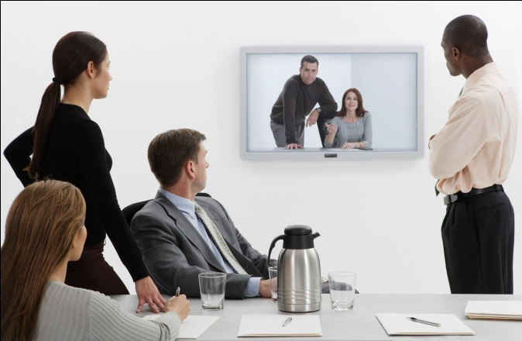


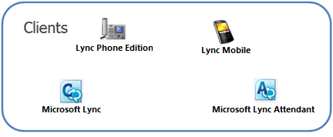
Make a Phone Call from Anywhere
The Microsoft Lync 2010 client works with Microsoft Lync Server, providing a software-powered telephone.
Users can contact anyone inside or outside of their company. It’s as comfortable as your old phone but a richer and more sophisticated experience.
Lync supports the following types of calls:
Computer to computer
Computer to telephone
Telephone to computer
Computer to audio conference
Video calls and conferencing
Using Lync 2010 means that users have all their principle communication choices - voice, e-mail, instant messaging, and conferencing - available and integrated on their computer.
Return to Voice Objectives

Slide 5
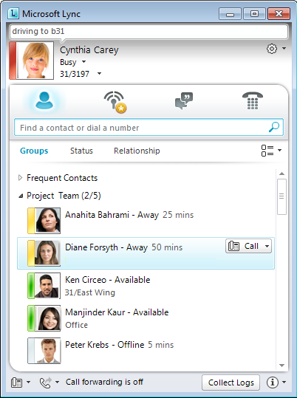
Make a Call
You can use the search bar to find someone or scroll to find anyone in your contact list.
Open Lync.
Type the person’s name or phone number in search bar.
Click Call on the person’s contact card,.
When you click to call the contact’s work number is the default number that is dialed.
You can click the Call menu to select other numbers to call the contact.
Learn more about Click to Call on the next slide.
Call menu for additional options
Search
Return to Voice Objectives

Slide 6
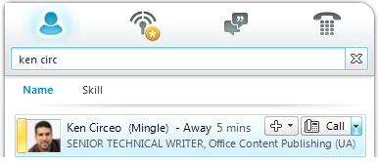
Click to Call
Lync 2010 offers the Click to Call feature.
When you click this icon Lync automatically dials the number for you.
The call connects using your Lync Phone Edition device.
If a device is not available the call connects through your Lync client.
Click to Call
Return to Voice Objectives
Notes:
DONE

Slide 7
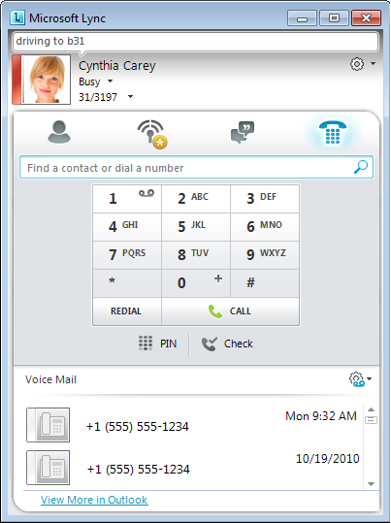
Use the Dial Pad to Make a Call
Click Phone tab to access Dial Pad.
Use the dial pad to manually enter a phone number to dial. For example, you can use the dial pad to dial 1-800-flowers.
Click Phone.
Click or type numbers on the Lync dial pad.
Click Call to dial number.
The dial pad responds to mouse clicks and keystrokes.
Click Call or press Enter to dial number.
Return to Voice Objectives

Slide 8
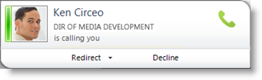
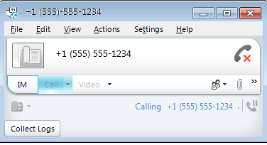
Answer a Call
Depending on your device setup, an incoming call takes place using one of the following methods:
Connected to a Lync Phone Edition device: Call is answered using the Speakerphone or Headset.
Lync without a device attached: Audio through the computer speakers.
Answer Call:
Click notification window for incoming call.
The Conversation window appears and the call begins.
Redirect or Decline Call:
Click Redirect call to another number such as your cell phone.
Click Decline to call send caller to voicemail if it is configured or disconnect caller.
Click the notification window to answer call.
Conversation window appears after accepting call.
Return to Voice Objectives
Notes:
**Need two slides one for incoming (new) call and one for current conversations**
[AK]
Toast and conversation window could use caller photos
Conversation window example could use an IM session to begin with (it is not clear how a user can get into this situation otherwise)
Other parts in the toast image are not from Lync – and should be removed
It may be worth mentioning that declining a call would send the caller to voicemail (if configured)

Slide 9
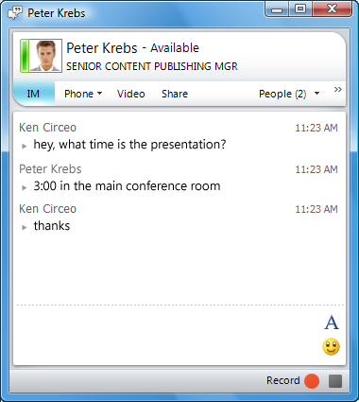
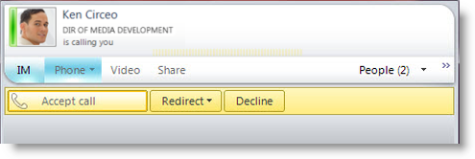
Accept Call During Conversation
During a conversation you can start a call in the conversation window.
Answer a Call In an IM
The Conversation Phone tab displays options on how to receive the call.
Click one of the following options:
Accept Call – accepts call and begins conversation.
Redirect – redirect to cell phone or other number.
Decline – declining the incoming call sends caller to voicemail if it is configured or disconnects caller.
Click Phone to initiate call.
Click Accept, Redirect or Decline.
Return to Voice Objectives

Slide 10
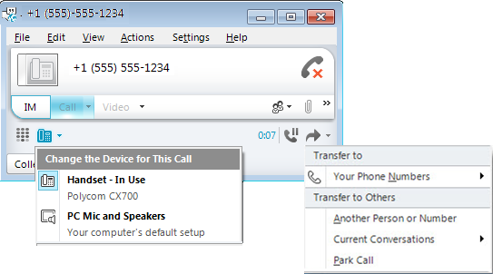
Manage a Call
During a call you can change the audio device, place the call on hold or transfer the call to another number.
Click the following options from Conversation window.
Click Audio Device to select between your headset, handset or computer audio.
Place the call on hold by clicking Hold.
Transfer the call to another number. Use transfer to remain on your conference call even when you have to leave your office.
Use the transfer menu to transfer call to another number.
Change the audio device during your call.
Return to Voice Objectives

Slide 11
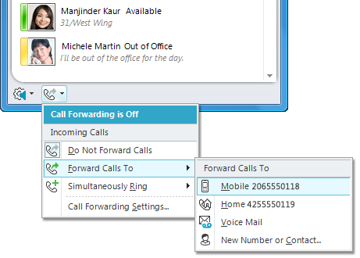
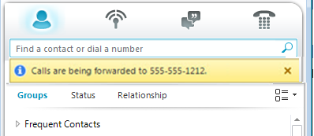
Phone Calls Get to the Right Place
Use Lync 2010 to forward calls to your cell phone or simultaneously ring your office and home numbers.
Quickly identify and change call forwarding settings.
Know at a glance when your calls are being forwarded.
Easily configure advanced call routing settings.
Take your calls with you.
Call-Forwarding Settings
Calls Forwarded Notification
Return to Voice Objectives

Slide 12
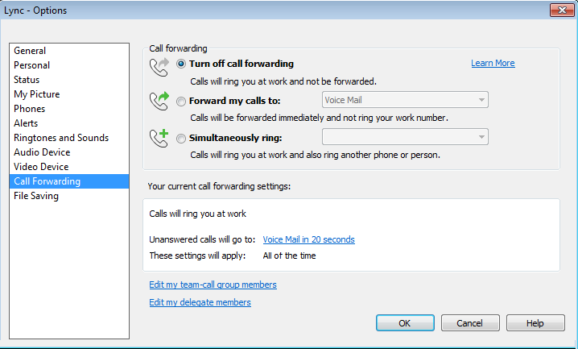
Forward a Call
You can send callers straight to your voice mail or to anyone you want to handle your calls while you are out.
It’s easy to set up full forwarding rules on the Call Forwarding tab.
Click Call Forwarding.
Click Call-Forwarding Settings.
Specify phone numbers on the Call Forwarding tab in Options.
Click OK to update call forwarding settings.
Click Call Forwarding.
Select one of the following options:
  Do Not Forward Calls
  Forward Calls To – Voicemail, Cell Phone, or other number
  Simultaneously Ring
Return to Voice Objectives
Notes:
DONE
[AK]
May want to call out quickly setting call forwarding using the fly-out menu to do one of the following:
Re-set call forwarding (to do not forward calls)
Set call forwarding to voicemail / cell / contact
Set simultaneous ring to delegates / team call group members
Also needs image update, Call forwarding dialog now shows summary clearly compared to earlier builds

Slide 13
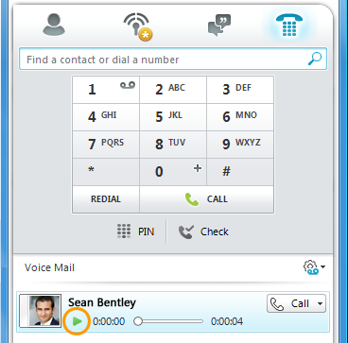
Follow up on Missed Calls
Manage phone messages using Lync 2010.
Know that you have missed calls and messages waiting at a glance.
Playback voice mail directly from Lync.
Easily reply to voice mail using chat or voice.
Listen to your Voice Mail
Click Phone in Lync.
Click Play to listen to received voice mail.
Click Call to reply to voice mail.
Visual Voice mail provides a dedicated view for voicemail with one click access to playback.
Return to Voice Objectives

Slide 14
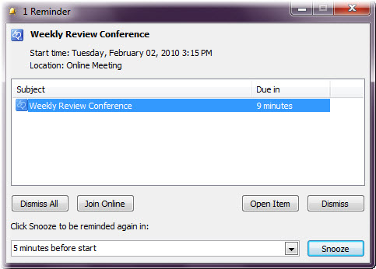
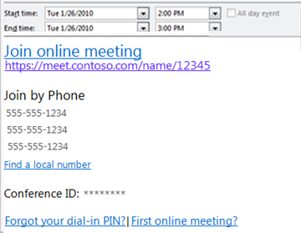
Join a Conference Call
Lync 2010 offers multiple options for connecting to a scheduled conference call.
Using Option A or B connects using Lync Phone Edition device by default. If device is not available you will connect to conference using computer speakers and microphone.
Option B Click Join Online Meeting from calendar invitation to connect to conference through Lync 2010.
Option A Click Join Online to join conference Call directly from Outlook calendar reminder.
Option C Manually dial the number using desk, cell or Lync Phone Edition device.
Return to Voice Objectives

Slide 15
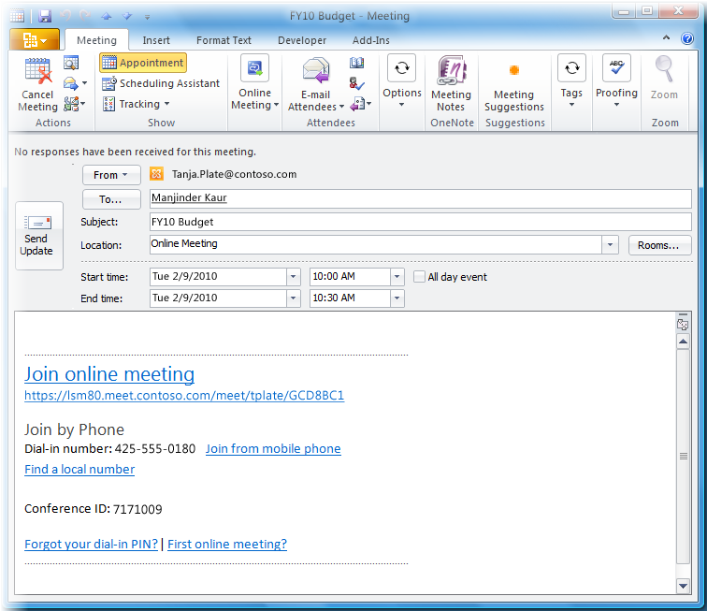
Online Meeting Invitation
The meeting invitation contains multiple ways to connect to Lync Online Meeting.
Join Online Meeting connects you to the meeting through Lync allowing you to hear conference call and see visual content such as web camera and desktop sharing.
Meeting Hyperlink provides a Internet browser method of connecting in the event the Join link fails or you do not have Lync installed.
Join by Phone connects you to the conference call if you are using a home or cell phone. It connects you through Lync if you are using Lync Phone Edition or the Lync Dial pad.
Conference ID required when prompted. You are not prompted when using Join Online Meeting or Meeting Hyperlink.

Slide 16
Activity 1
This activity prepares Lync users for Online Meetings using voice. Practice this activity during a small or informal team meeting. This scenario uses a conference room setting with a conference phone as primary audio.
Schedule an Online Meeting
Open Outlook 2010 and click New Items, and then click Online Meeting.
Complete invitation fields and send the invitation.
  To Recipients
  Subject
  Location
  Start and End Time
Join the Meeting
Open Invitation and click Join Online Meeting.
Click Use the following on the Join the conference audio dialog window.
Click drop down menu and enter your conference room telephone number.
Click OK.

Slide 17
Activity 2
Practice using Lync touchtone commands during a call.
Touchtone commands also referred to as Dual Tone Multi-frequency (DTMF) help you control the conference call, allowing you to admit or mute participants, and disable announcements.
Join an Online Meeting and connect to conference call using desk phone.
Use desk phone dial pad to press one of the following touchtone commands and listen to description.
  *6 - Mute or unmute yourself
  *4 - Mute or unmute all other participants
  *7 - Lock or unlock the conference call
  *9 - Enable or disable announcements for participants entering and exiting the conference.
  *3 - Privately play participant roll call in the conference.
  *8 - Admit all participants currently in the lobby to the conference.
  *1 - Play a description of the available touchtone commands.
Return to Voice Objectives
Notes:
*Beta note*
DTMF commands are not currently available through the Lync Dial pad (3-1-10)

Slide 18
Last Minute Resolutions
Most users have experienced an unexpected moment during a conferencing session.
The following provides tips on addressing last minute issues in an Online Meeting.
Issue: Conference room phone or meeting participant cannot dial into the Online Meeting.
Resolution: Use Invite by Phone to call participant or connect to conference room phone.
Click the People menu and then click Invite by Name or Phone Number
Enter number for participant’s desk or cell phone or the conference room phone number, and click Call.
Issue: A participant’s voice echoes throughout the call.
Resolution: This occurs if a participant is connected to the Online Meeting through multiple devices, such as both computer audio and cell phone audio. This can also occur inside a large conference room if the meeting is using a podium and panoramic video with audio device.
The participant should mute computer speakers and computer microphone.
Mute desk phone and verify echo has stopped.
Unmute primary device to use during Online Meeting.
Return to Voice Objectives
Notes:
Short instructions for resolving common “uh oh” moments in a conference room scenario. Intended to be quick one or two minute steps, not troubleshooting that may delay meeting start.

Slide 19
Video Objectives
Video
This section covers the following:
Join a Video Call
Accept a Video Call

Slide 20
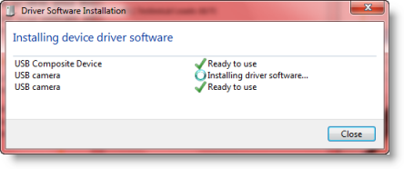
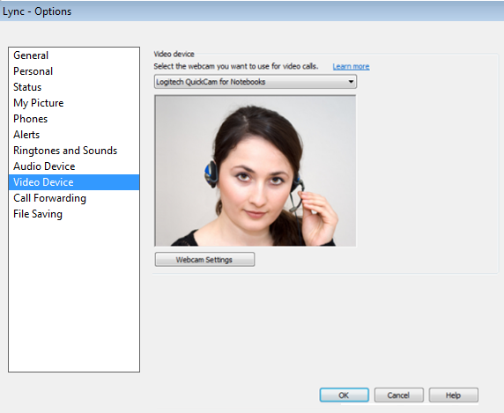
Video Overview
For the closest thing to a face-to-face conversation, connect a webcam to your computer.
Using a webcam in Lync 2010 to display yourself to other participants is a seamless experience.
Certified UPnP webcams are detected automatically by Lync on Windows XP, Vista and Windows 7.
You do not need to install a webcam to view another participant’s video in a Online Meeting.
Configure webcam settings from Video Device in Lync Options.
Click Tools and then click Options.
Configure webcam settings under Video Device.
Plug in a USB webcam and Windows automatically searches for driver software.

Slide 21
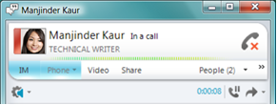
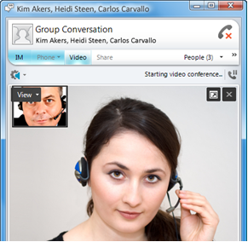
Join a Video Call
If you have a webcam set up, you can choose to allow your contact to see you as you converse. If you accept someone’s incoming video call to you, they won’t see you until you add video from your side of the conversation.
Join a Video Call
Click Video in the conversation
window to start your webcam and initiate the video conversation.
Click Video to start your webcam.
Picture in picture view of yourself, click View to set options or hide.
Return to Voice Objectives

Slide 22
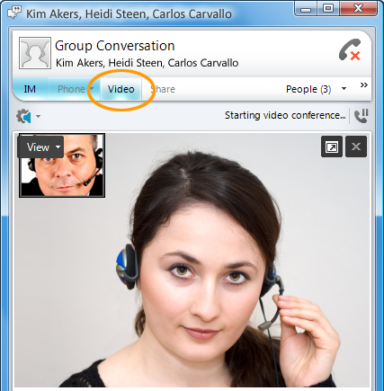
Accept a Video Call
You don't need a webcam to accept a video call from another Office Lync 2010 user.
If you don't have a webcam, you can view the caller’s video feed, and the caller will see a video icon placeholder for your feed. Your caller won’t see you unless you add your own video feed to the conversation.
Accept a video call.
Another participant in Online Meeting begins video.
Lync automatically displays participant video in conversation window.
Click Start my video to display your webcam to other participants.
Click View to show your preview window or change webcam settings.
Click View to display your preview window or modify webcam settings.
Click Full screen button to maximize video window.
Return to Voice Objectives

Slide 23
Review
In this course we covered the following voice and video features of the Lync 2010 client.
Make a Call
Answer a Call
Manage a Call
Forward a Call
Follow up on Missed Calls and Voice Mail
Join a Conference Call
Join a Video Call
Accept a Video Call

Slide 24


© 2010 Microsoft Corporation. All rights reserved. Microsoft, Exchange ActiveSync, Excel, Lync, Outlook, PowerPoint, SharePoint, SQL Server, Windows, Windows Live, Windows Mobile, Windows Server, and other product names are or may be registered trademarks and/or trademarks in the United States and/or other countries/regions. The information herein is for informational purposes only and represents the current view of Microsoft Corporation as of the date of this presentation. Because Microsoft must respond to changing market conditions, it should not be interpreted to be a commitment on the part of Microsoft, and Microsoft cannot guarantee the accuracy of any information provided after the date of this presentation. MICROSOFT MAKES NO WARRANTIES, EXPRESS, IMPLIED OR STATUTORY, AS TO THE INFORMATION IN THIS PRESENTATION.
BACK TO OBJECTIVES

